Slide 1


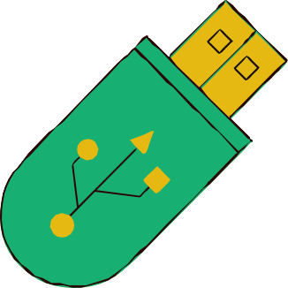
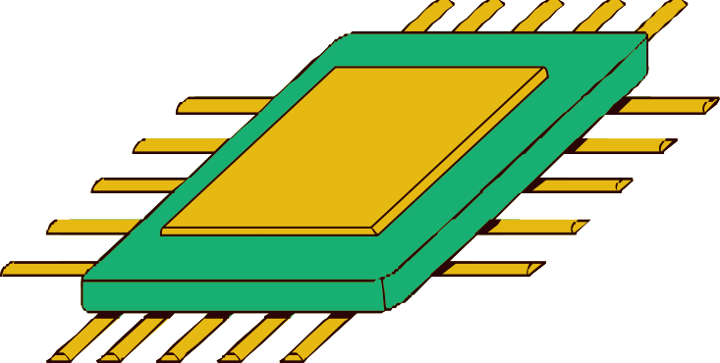
FAST TAG FRAUD DETECTION
USING MACHINE LEARNING TECHNIQUE
Presented by:
Pratiksha Saheb

Slide 2



PRESENTATION OUTLINE
Introduction
Dataset Overview
Exploratory Data Analysis (EDA) Feature Engineering
Data Preprocessing Model Development Model Evaluation

Slide 3


INTRODUCTION
tion ns using
sification
TO CREATE A ROBUST MODEL THAT CAN ACCURATELY IDENTIFY INSTANCES OF FRAUDULENT ACTIVITY, ENSURING THE INTEGRITY AND SECURITY OF FASTAG TRANSACTIONS.

Slide 4

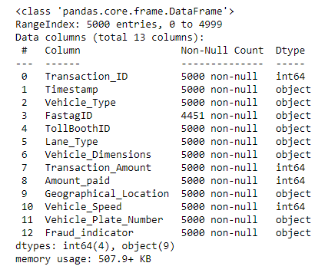

DATASET OVERVIEW

Slide 5
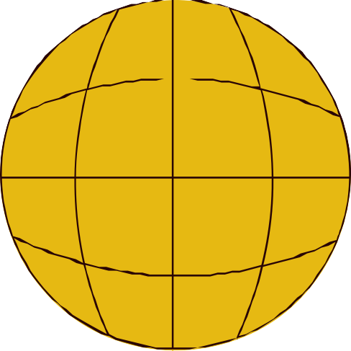

WHAT IS MACHINE LEARNING?
Machine learning is a subset of AI that focuses on the development of algorithms and models that enable computers to learn from and make predictions or decisions based on data.
It's a key driver of AI applications, including natural language processing, image recognition, and recommendation systems.

Slide 6



PROJECT KEY STEPS
DATA EXPLORATION
FEATURE ENGINEERING
MODEL DEVELOPMENT
REAL TIME FRAUD DETECTION
EXPLANATORY ANALYSIS

Slide 7

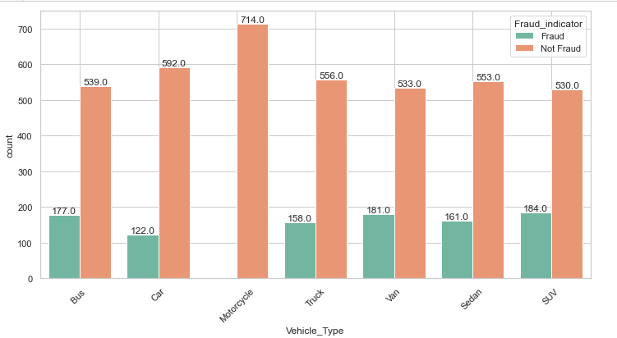
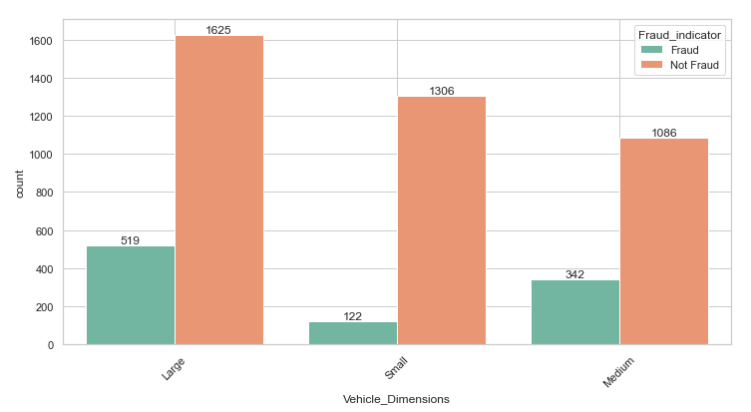
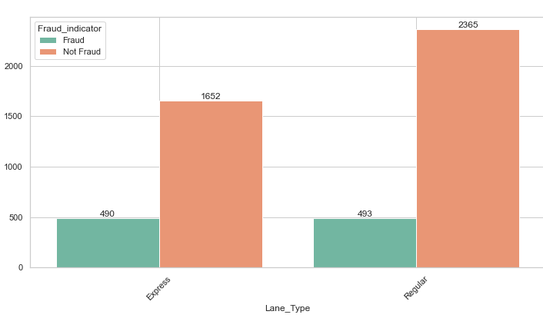
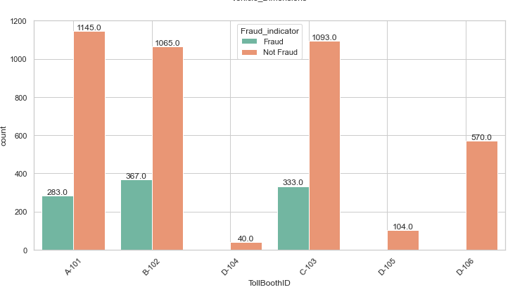

EXPLORATORY DATA ANALYSIS (EDA)

Slide 8

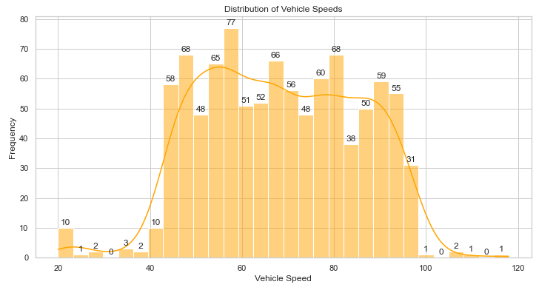

EXPLORATORY DATA ANALYSIS (EDA)
The highest frequency is observed in the 50-60 km/h range, with 77 vehicles. This indicates that the most common vehicle speed falls within this range.
Another notable peak is in the 60-70 km/h range, with a frequency of 66 vehicles.Most vehicles are traveling within a specific range (40-80 km/h), with fewer vehicles at lower and higher speeds.

Slide 9

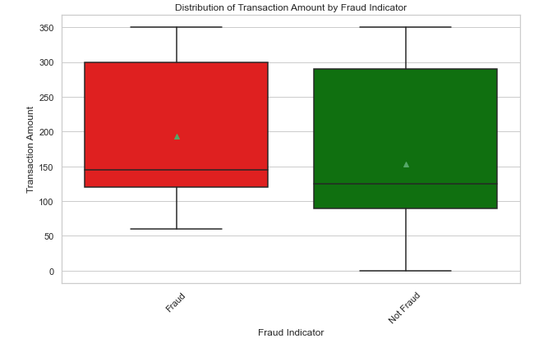

EXPLORATORY DATA ANALYSIS (EDA)
The interquartile range (IQR), which represents the middle 50% of data, is slightly larger for fraudulent transactions compared to non-fraudulent ones. This suggests that there is more variability in the amounts of fraudulent transactions.
The range of transaction amounts for both categories is similar, but fraudulent transactions show a slightly higher maximum.

Slide 10

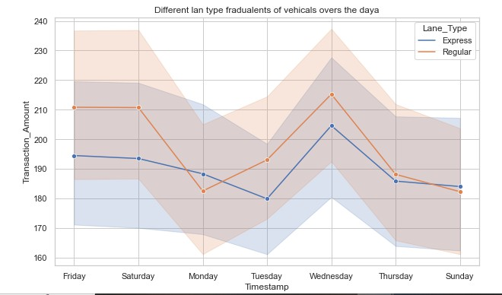
EXPLORATORY DATA ANALYSIS (EDA)
The consistently higher transaction amounts in Regular lanes might indicate that these lanes handle transactions that are either larger in amount or more frequent than Express lanes.
The peak on Wednesday in Regular lanes could point to higher traffic volume or higher value transactions occurring mid-week.

Slide 11

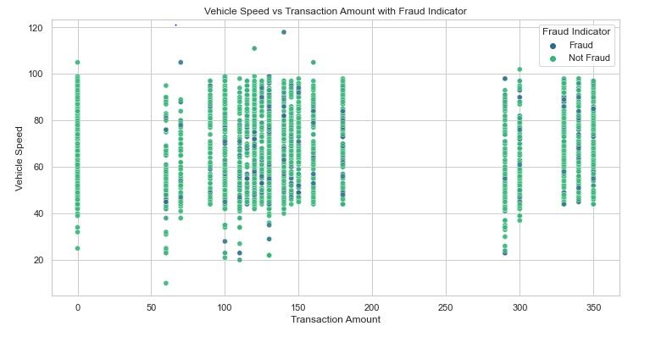
EXPLORATORY DATA ANALYSIS (EDA)
Illustrates the relationship between speed and transaction amount, highlighting transactions flagged as fraud. This can help identify unusual combinations of speed and transaction amount associated with fraudulent activities.

Slide 12

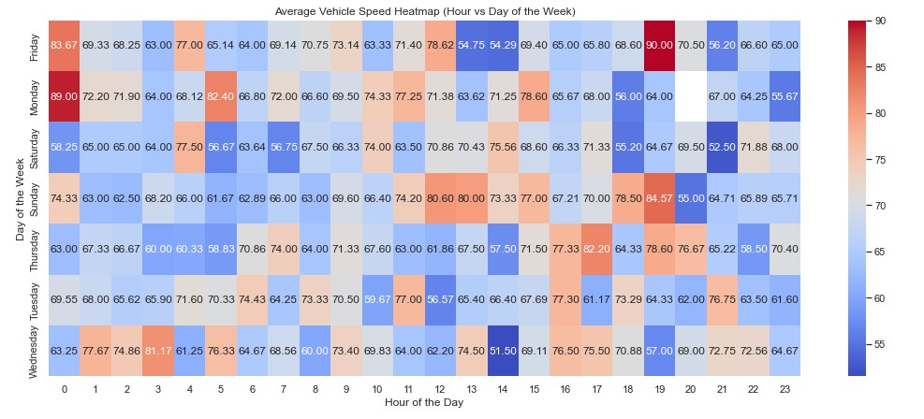

EXPLORATORY DATA ANALYSIS (EDA)

Slide 13
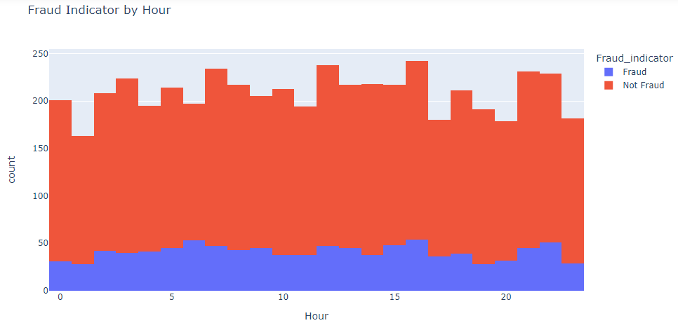

FEATURE ENGINEERING
Feature engineering involves creating new features or transforming existing ones to improve the model’s performance.
By carefully engineering features, we improve the model’s ability to learn from the data, leading to better predictions

Slide 14

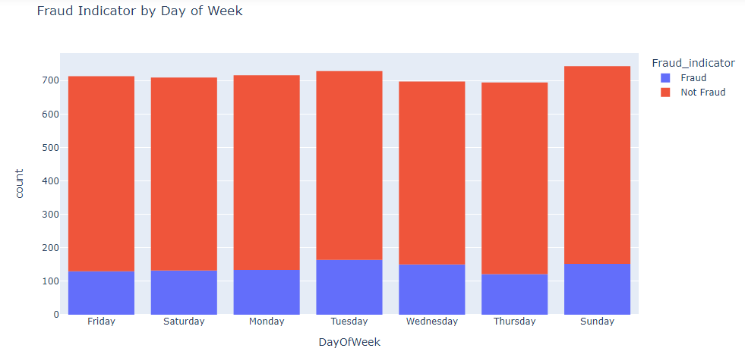

FEATURE ENGINEERING
The data suggests a possible correlation between fraudulent activity and transactions occurring on Tuesdays, Wednesdays, and Sundays.

Slide 15

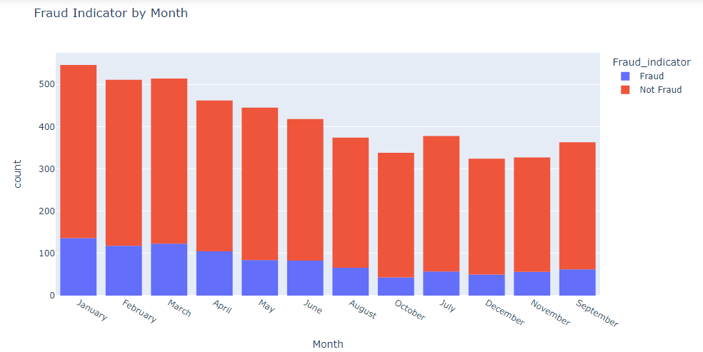
FEATURE ENGINEERING
The data suggests a possible correlation between fraudulent activity and transactions occurring on January, February, and March.

Slide 16

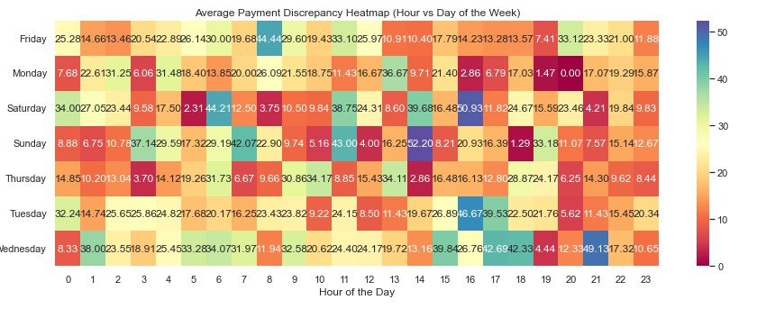

FEATURE ENGINEERING

Slide 17

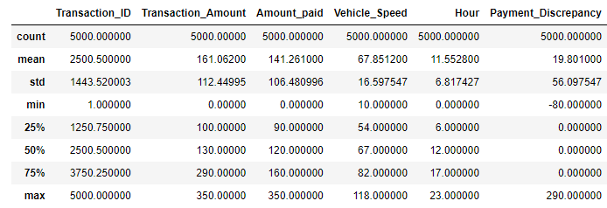
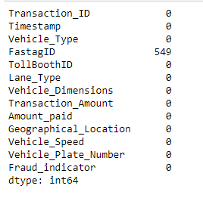

DATA PREPROCESSING
Handling Missing Values :
Missing values in the dataset were handled using fillna technique to ensure the model has a complete dataset for training.
For numerical features, we used the median value of each column to fill in the missing values.
The median is less sensitive to outliers compared to the mean, making it a robust choice for imputation

Slide 18
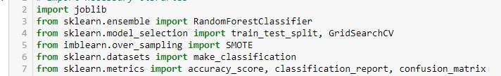
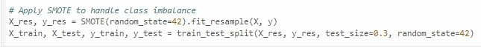
MODEL DEVELOPMENT
Random Forest is a powerful and versatile ensemble learning algorithm that is used for classification and regression tasks. It builds upon the concept of decision trees, combining the output of multiple trees to improve predictive performance and control overfitting.
SMOTE (Synthetic Minority Over-sampling Technique): SMOTE is a popular method to address class imbalance. It works by generating synthetic samples for the minority class (in this case, fraudulent cases) to make the dataset more balanced. This is done by interpolating between existing minority class examples rather than simply duplicating them.

Slide 19

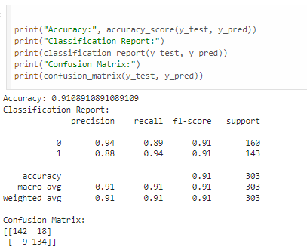


MODEL EVALUATION

Slide 20


THANK YOU

